Slide 1


Host Your Own Website Workshop
Finally a place to store all those memes
Hosted by:

Slide 2

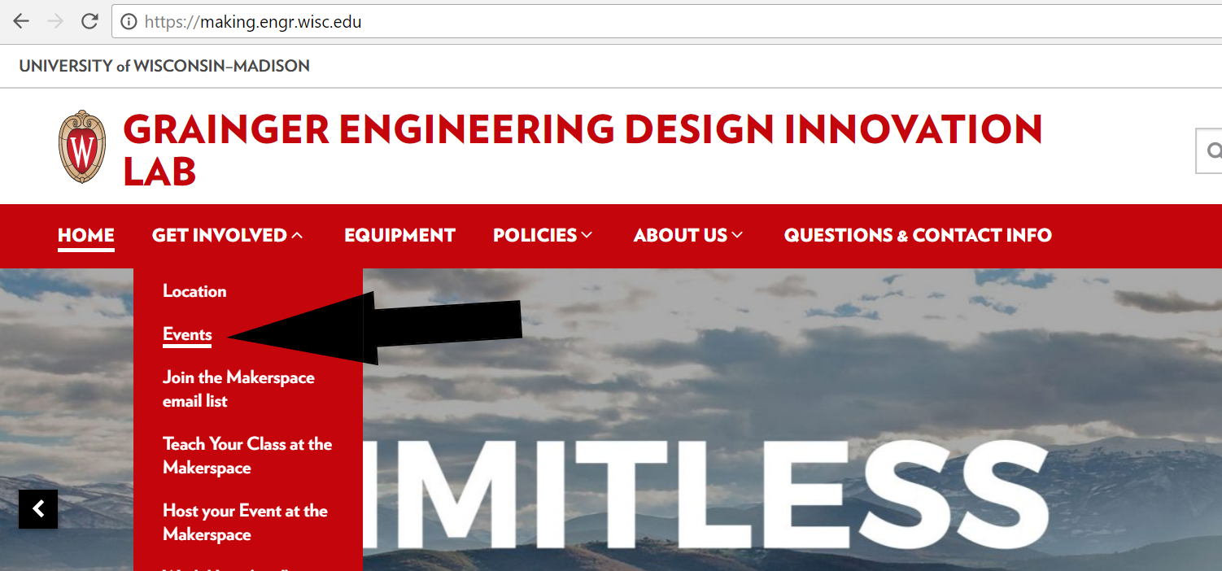
More Workshops This Year!
https://making.engr.wisc.edu

Slide 3
What makes up a webpage
HTML (Hyper Text Markup Language)
CSS (Cascade Style Sheet)
JS (JavaScript)
HTML creates the structure of the page
CSS adds the styling
JS brings programmatically functionality

Slide 4
The Browser
Just a program
Knows how to display HTML and CSS
“Compiles” and runs the JavaScript code
Works on about every device
Don’t need browser to get webpage…
only to display it

Slide 5
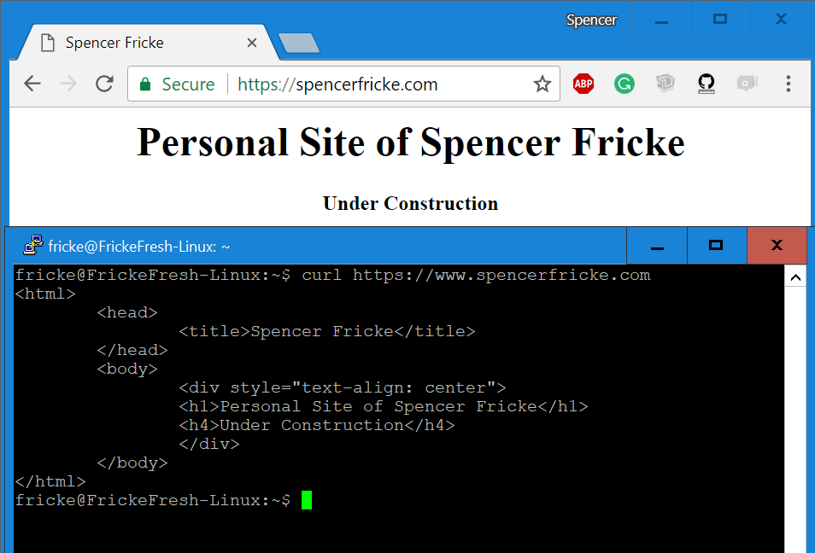
Website is just text at core

Slide 6
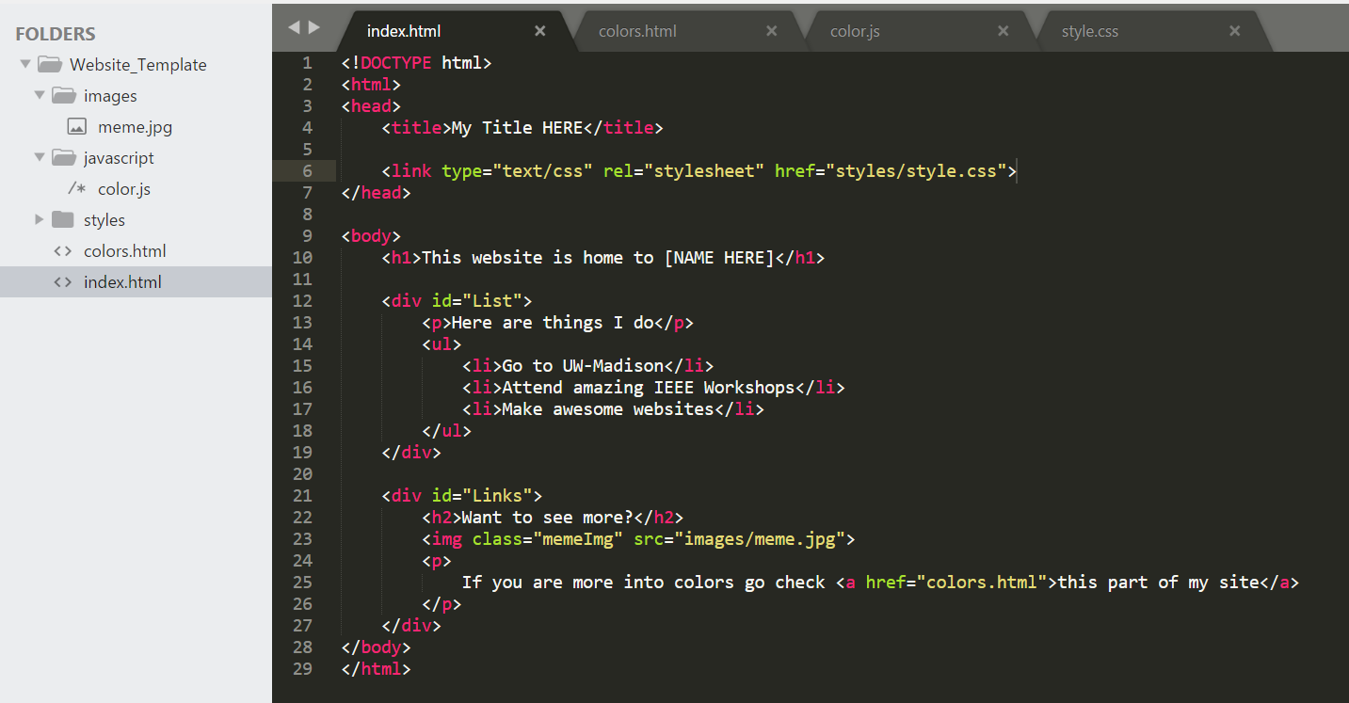
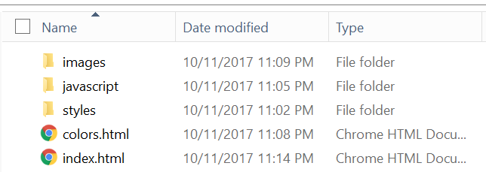
Websites are just files

Slide 7
How to edit site
Need a Text Editor
Get a good one to save you time
My top two suggestions:
Sublime Text 3
Great for editing files and lots of support
Atom
Has built in server to let your view webpages severed from server

Slide 8
What you need for Public Webpage
Domain Name
Server to hold your web files
Also need to have public IP

Slide 9
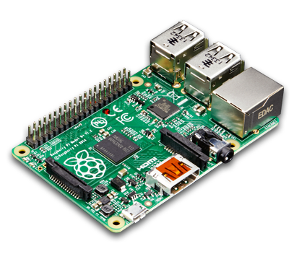
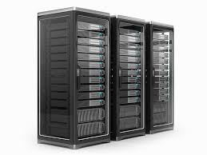
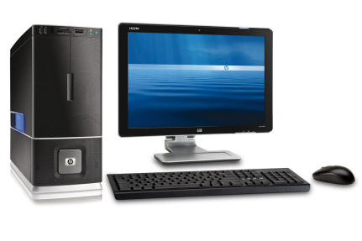
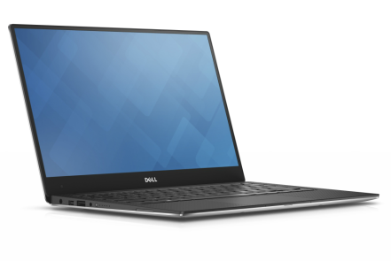


What is a Server?
Any “Computer” with a way to store data, run processes, and can connect to other computers can be a Server

Slide 10
Connect to Server
HTTP
Stands for Hypertext Transfer Protocol
Way of sending text to servers and getting a response back from them

Slide 11
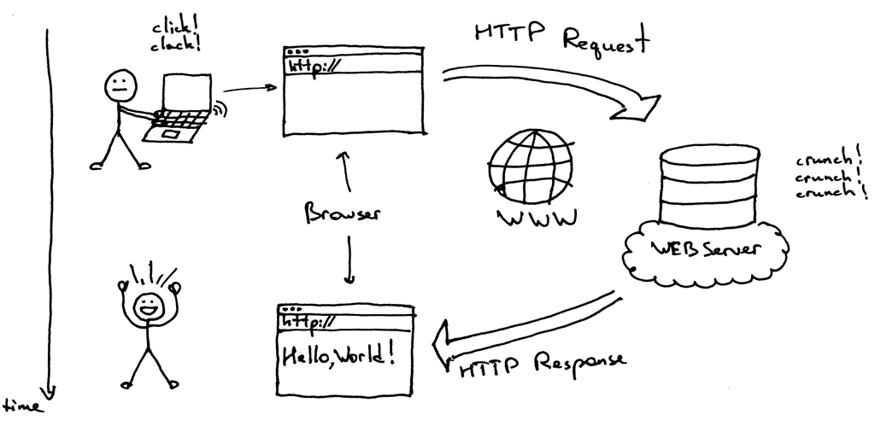
How Loading a Website Works

Slide 12
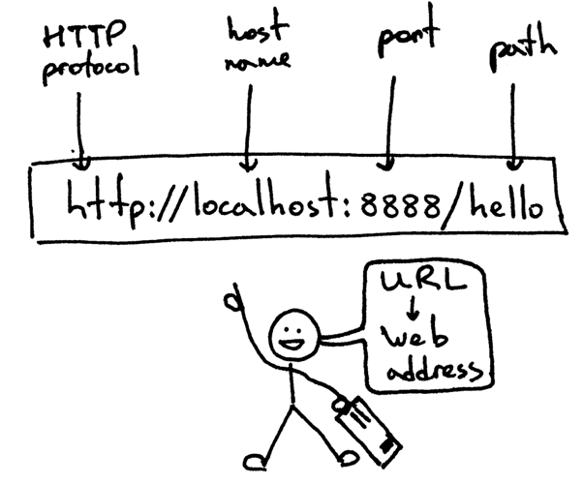
How Loading a Website Works

Slide 13

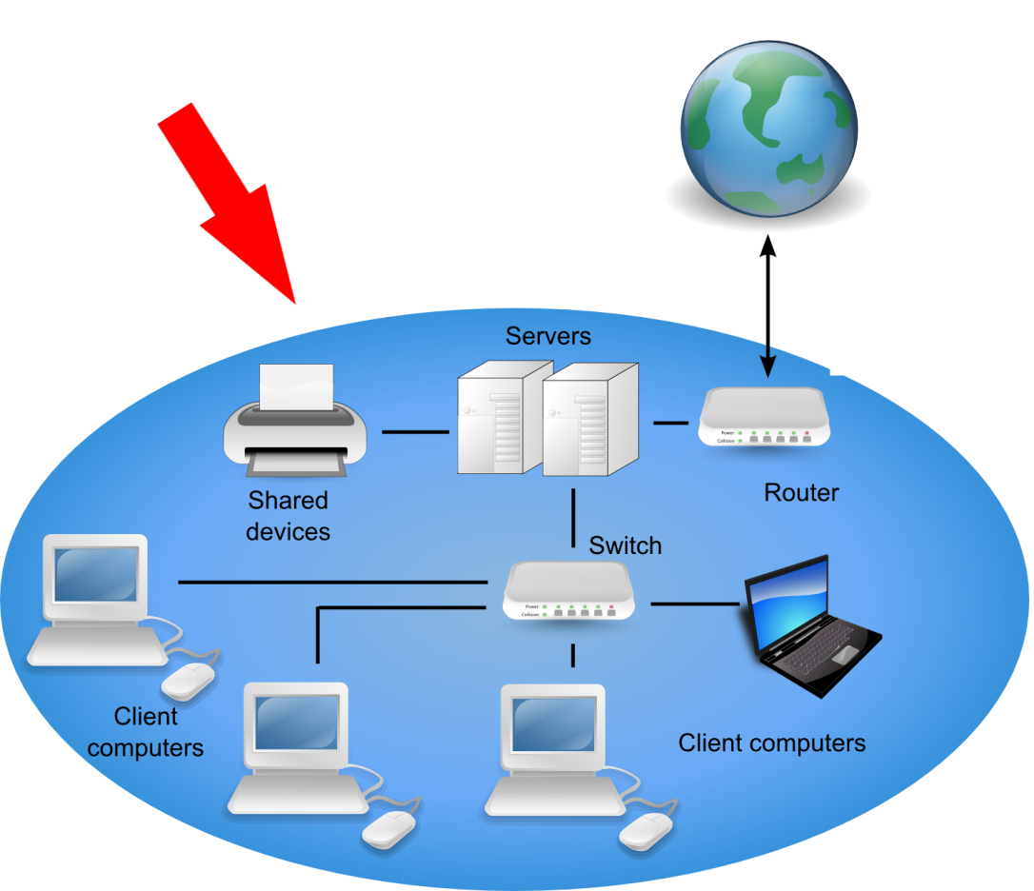
How Internet Works
University of Wisconsin - Madison

Slide 14
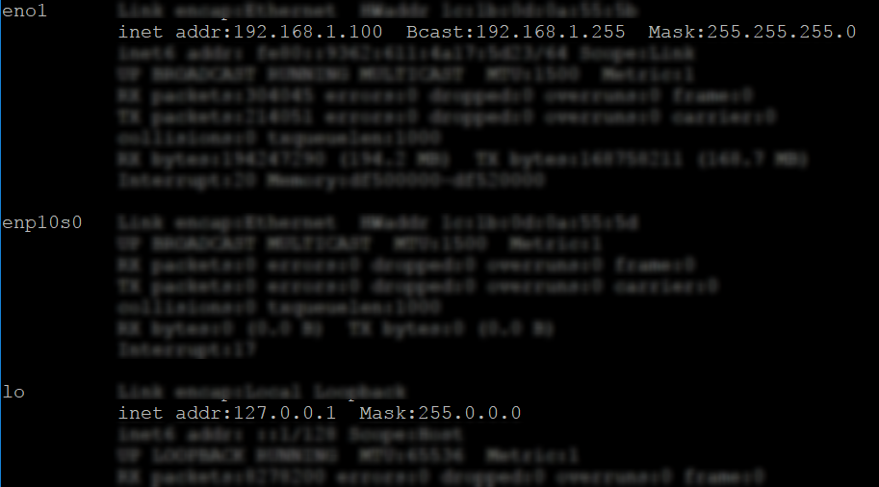
IP Addresses
127.0.0.1 is your computer
Also called localhost
192.168.1.100 is IP on local network (in this case)
Can’t get too from another network

Slide 15
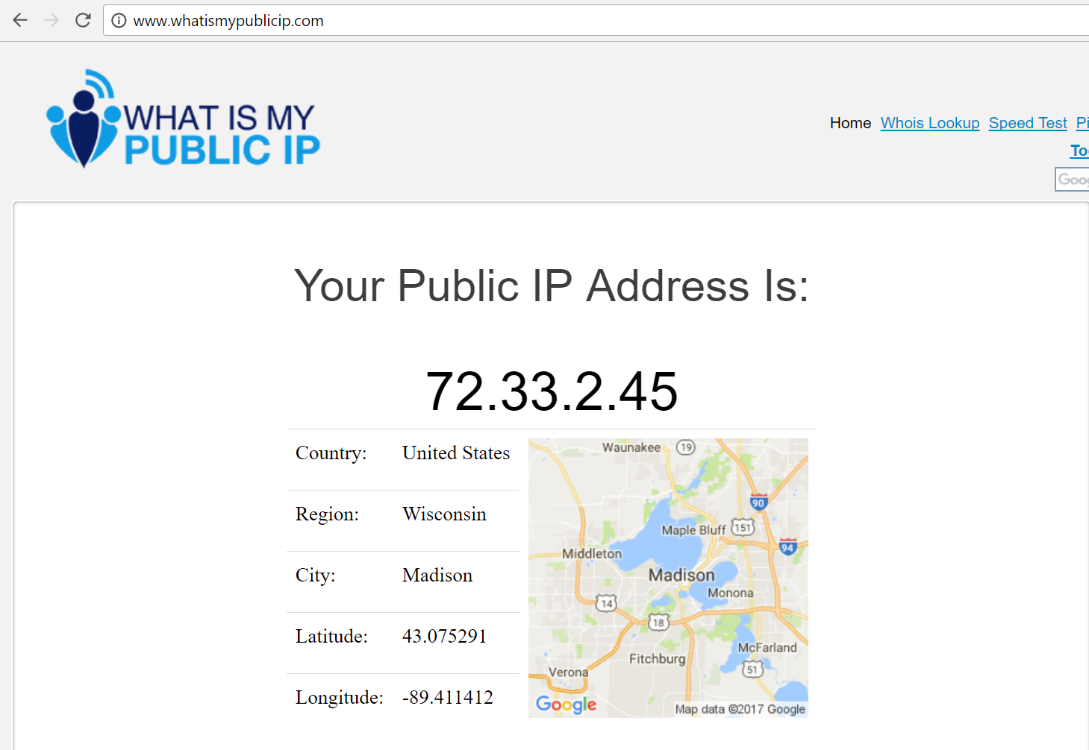
IP Addresses
Each local network has a “Public Facing IP”

Slide 16
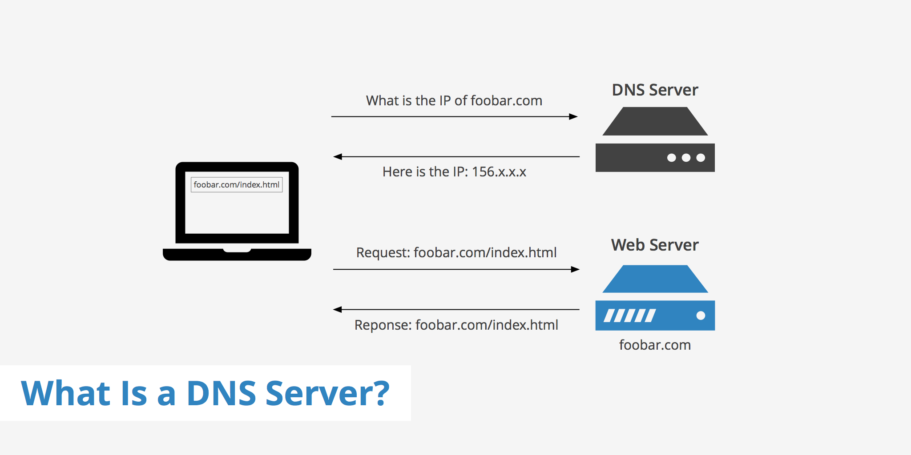
What is a Domain

Slide 17

How much does it cost?
…if you are a student

Slide 18
Getting a Domain name
Domain companies LOVE giving 1-year promotions
Namecheap gives students 1 free domain
Domain.com gives a free year with MLH code
Domain names can be used to redirect to other websites
But the address will change in the browser

Slide 19
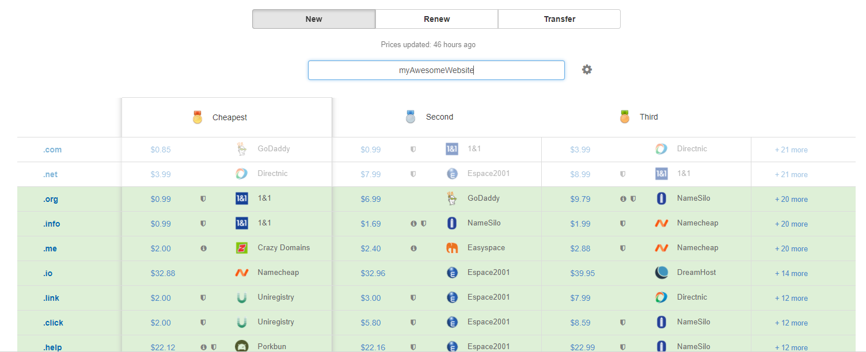
How to check a domain
http://domcomp.com

Slide 20
Have Domain, now what?
Need to direct it
Give a “A Record” to the IP of server
Set “Nameservers”
Tell it where to find IP
Namecheap and Domain.com have this supported
Use a CDN like Cloudflare
Free (for non-business websites)
Can prevent DDoS attacks
Shows detailed analytics

Slide 21
Where to host server
Digital Ocean
$50 of credit for students ($5/month for lowest tier)
AWS
About $100 credit for students
Azure
About $200 credits for students
Your computer
Can host a Raspberry Pi from apartment
Many of free host sites (GitHub.pages, wordpress, etc)
Will display their domain when on page

Slide 22
Static or Served page
Want webpage to talk to other sites/servers?
Need to serve page from server
Static pages just download and display files
Served pages have connection with server
Cross-Origin Policy
Can’t just randomly call other servers if static

Slide 23
Starting a server is easy
Can do in with one line
in Python
in Node.js
in Golang
…
Maintaining it becomes more of the issue

Slide 24

Will want HTTP Server
Nginx or Apache
Both HTTP Server
Redirect to port where Server code is running

Slide 25
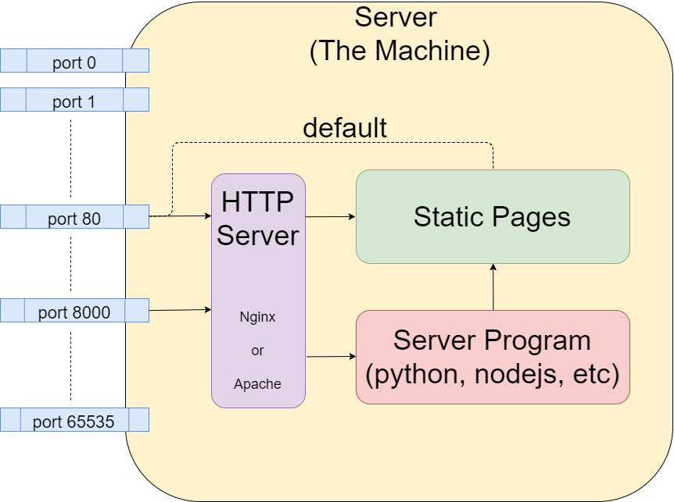
Ok, I am so lost

Slide 26
Decide What You Want First
Do I need to update this site constantly?
Is someone updating the site?
Do I want my domain displayed?
Is my website static or have functionality
How much do I want to spend
In money
In my time

Slide 27
Time to get some practice!
tinyurl.com/WebsiteWorkshopIEEE
[ Note: it’s case sensitive ]

